Slide 1
XFM Vending Machine
Joseph Olin
Michael Roark
Branden Wagner
Notes:
Presenter: Joseph
All team members speak their name in alphabetical order.
X to the F to the M to the V.

Slide 2
Purpose
Demonstrate how a familiar task, such as tending bar, can be handled by a low cost intelligent robot
Notes:
Presenter: Joseph
Introduction to the project and the overall goal.

Slide 3
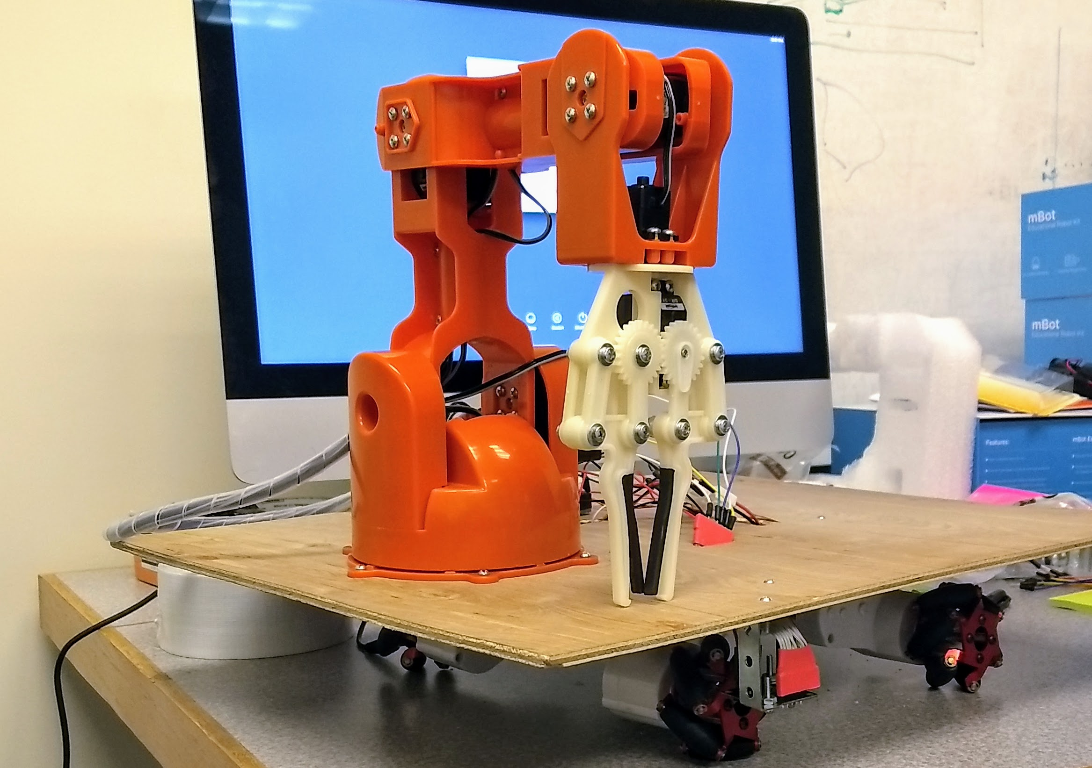
What is XFM Vending Machine?
A robot that delivers
food items to customers
sitting at a counter
Notes:
Presenter: Joseph
Explains what the robot does and why it came about.

Slide 4
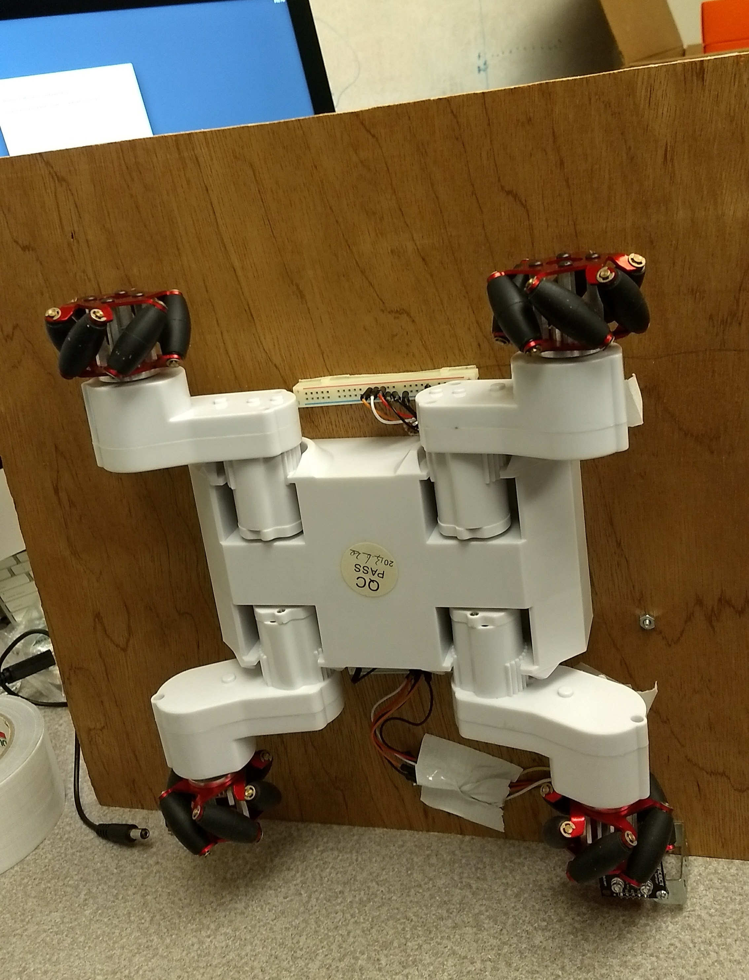
How?
The robot uses
Wheeled navigation
Ability to grab and drop
Color reading
Path following abilities
Notes:
Presenter: Joseph
Overview of how the components work to deliver a mint.
Mention Brazzerios inspiration for the color reading.

Slide 5
Operational Flow
Finds path
Follows path
Detects order
Delivers food
Reverses direction
Notes:
Presenter: Michael
Gives a general view of the operation cycle of the machine.

Slide 6
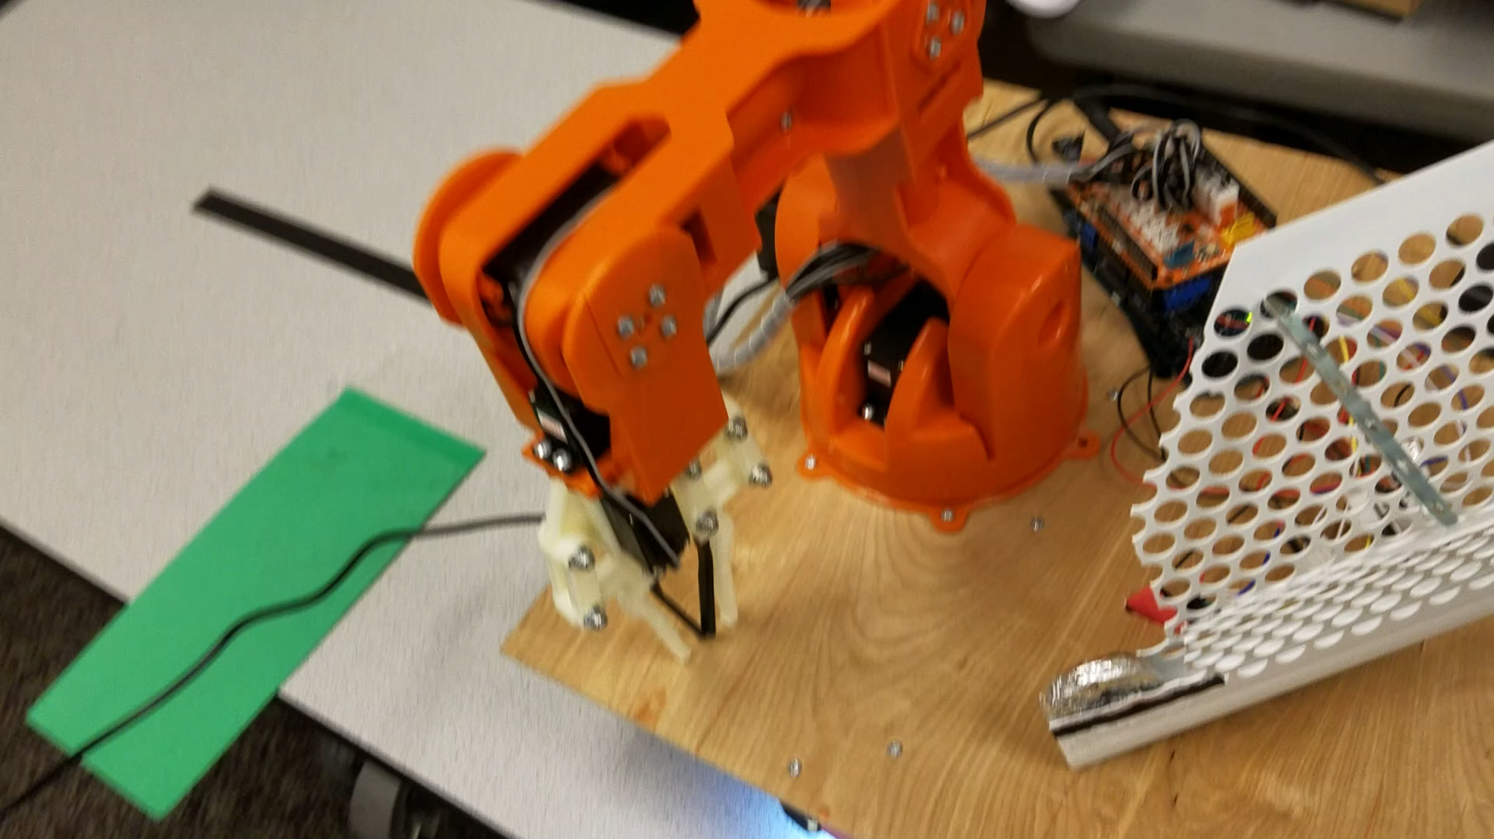
DEMO
Notes:
Presenter: Michael
Video

Slide 7
Components List
Arduino Braccio Arm
Rover 5 chassis
Arduino Adafruit microcontroller
RGB color sensor
Line follower sensor
A bag of mints
12V DC battery power supply
5V DC power from wall
Notes:
Presenter: Michael
Covers all the components we used to assemble the robot.

Slide 8
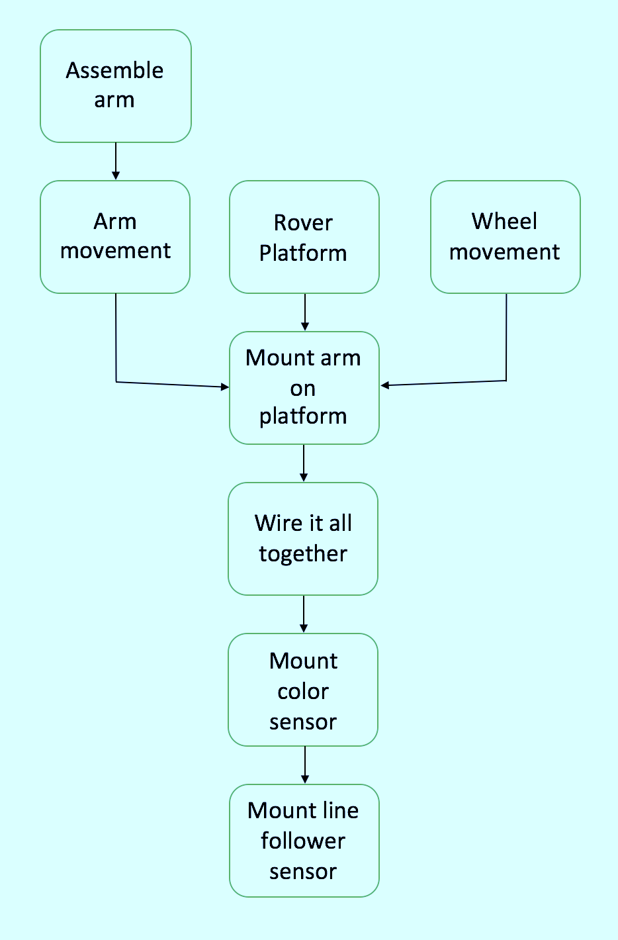
Development
Physical
Software
Notes:
Presenter: Branden
Starts with physical and moves into software making direct comparisons.
About $400 of hardware.
About 300 lines of code.

Slide 9
What’s left?
Further development of the line follower sensor
Optimize the performance of the robotic system based upon discrete performance measures
Measure delivery speed
Measure percentage of successful deliveries
Notes:
Presenter: Branden
Mention Cost, Simplicity, Flexibility

Slide 10
References
W. I. O. T. Made by Windows IoT (Windows IoT, Aparajita Dutta et al), “What Color is it?,” Hackster.io, 25-Sep-2015. [Online]. Available: https://www.hackster.io/windows-iot/what-color-is-it-578fdb. [Accessed: 14-Apr-2017].
“Braccio,” Arduino Open Source Hardware and Software for electronic projects. [Online]. Available: http://www.arduino.org/products/tinkerkit/arduino-tinkerkit-braccio. [Accessed: 14-Apr-2017].
“Pololu - QTR-8RC Reflectance Sensor Array,” Pololu Robotics & Electronics. [Online]. Available: https://www.pololu.com/product/961. [Accessed: 14-Apr-2017].
Notes:
Presenter: Branden
See these for additional information.
First is the color matcher, second is documentation for the Braccio arm, and last is documentation for the line follower.
After this slide we move into the Q&A portion.

